Slide 1

Championships analysis

Slide 2

TABLE OF CONTENTS
INTRODUCTION
DATA OVERVIEW
EDA
VISUALIZATIONS
CONCLUSION
RECOMENDATTION
SOURCE
THANKYOU

Slide 3
INTRODUCTION
has become one of the world's most popular esports games. Developed and published by Riot Games, this first-person shooter was launched in the summer of 2020 and has swiftly gained widespread acclaim, attracting millions of daily players from around the globe. The competitive landscape of Valorant sees players and teams from diverse regions competing in events as they vie for the coveted title of Valorant champions..

Slide 4
DATA OVERVIEW
The 2022 Valorant Champions, an esports tournament dedicated to the renowned video game Valorant, represented the pinnacle of competitive gaming. This second edition of the Valorant Champions was the culminating event of the Valorant Champions Tour for the 2022 Valorant competitive season. Notably, the data being explored and discussed here was meticulously collected during the tournament, adding an extra layer of significance to the insights derived from this dynamic and highly anticipated esports event.
Set against the backdrop of Istanbul, Turkey, from August 31 to September 18, 2022, the tournament not only showcased the exceptional skills of participating teams and players but also provided a rich dataset that allows us to delve deeper into the intricacies of competitive Valorant gameplay during this exciting period.

Slide 5
EXPLANATORY DATA ANALYSIS
Various aspects of the data have been compared against each other to get a better grasp of wat affects gameplay and wins and it has been presented in visuals

Slide 6
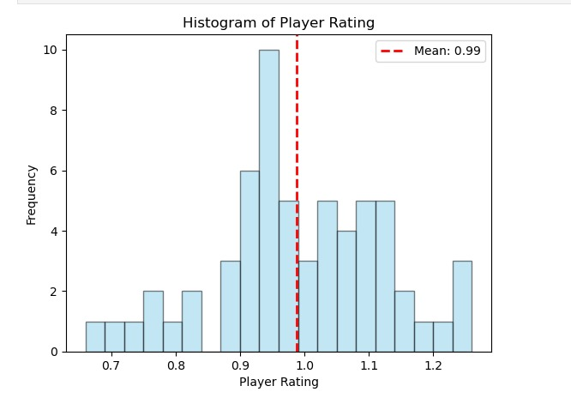

Slide 7
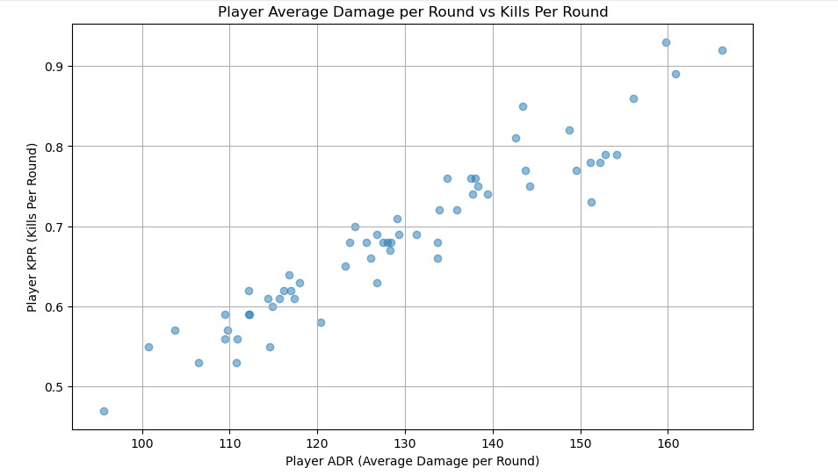

Slide 8
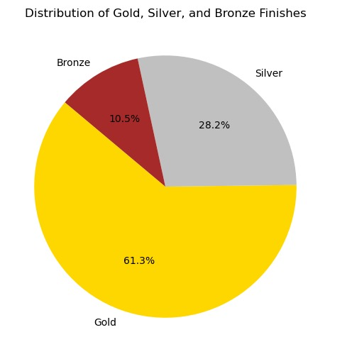

Slide 9
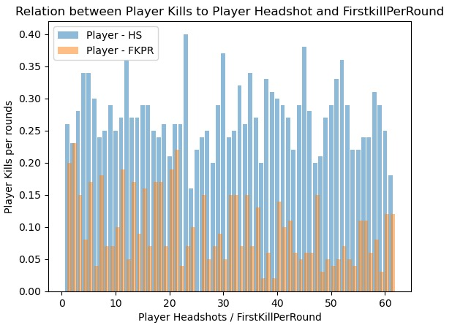

Slide 10
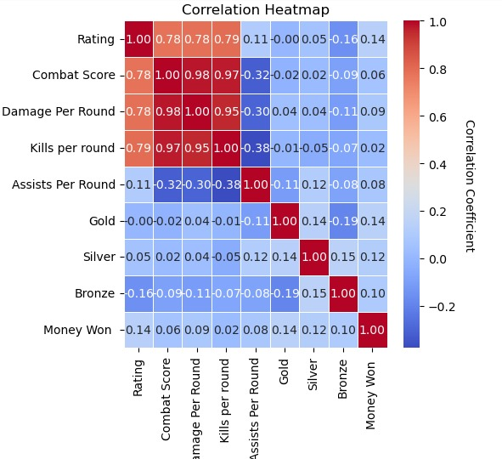

Slide 11
CONCLUSION
Upon analyzing the Valorant statistics, it's evident that their accuracy and strategic decision-making stand out prominently. The notable headshot percentage and kill-to-death ratio reflect a commendable proficiency in gunplay, indicating a solid foundation in securing crucial eliminations.
Theres a very clear indication that accuracy of the players (Headshots)affect how many kills they make inturn affecting how the rounds turn out
A player's aggressiveness and confidence during entry significantly correlate with an increased likelihood of securing first kills per round. When a player adopts a more assertive approach in entering engagements, they tend to catch opponents off guard, capitalizing on moments of vulnerability. The confidence to initiate these encounters often translates into quicker reactions and precise aim, contributing to a higher probability of securing the crucial first kill in a round.
Aggressive entry playstyle not only disrupts the opponent's defensive setup but also establishes early map control, providing the team with a strategic advantage. The psychological impact on adversaries can be profound, forcing them to adapt to the assertive pace set by the aggressive player. This disruption in the opponent's rhythm can create openings for the rest of the team, leading to a domino effect in securing subsequent kills and controlling the flow of the round.

Slide 12
RECOMENDATION
In light of these findings, I recommend they consider an entry fragging role that capitalizes on their accuracy and initiates engagements effectively. This playstyle aligns well with their demonstrated skills, allowing them to contribute significantly to securing map control for the team. Their efficiency in securing eliminations also positions them as a valuable asset in clutch situations, where their precision can be a game-changer.
.
To further enhance their impact, diversifying their agent pool could be beneficial. This adaptability will empower them to navigate various in-game scenarios, contributing to a more well-rounded and versatile playstyle.
Their data-backed strengths are impressive, and I encourage them to explore different strategies to find the playstyle that optimally complements their unique skill set. Keep refining the approach, and their contributions to the team will undoubtedly continue to thrive

Slide 13
SOURCE
The dataset utilized in this analysis was graciously provided by kggle a reputable source for comprehensive esports data. Their commitment to delivering accurate and up-to-date information has significantly enriched our exploration of the 2022 Valorant Champions tournament. We extend our appreciation for their dedication to fostering transparency and insight within the esports community.
LINKS : https://www.kaggle.com/datasets/evangower/valorant-esports-top-earnings
https://www.kaggle.com/datasets/shihouinyoruichi/valorant-champions-2022-istanbul-stats?rvi=1

Slide 14
Thank you all for being here and taking the time to view the presentation.

